Slide 1
Atmospheric circulation
Silvia Caldararu
Email: caldaras@tcd.ie

Slide 2

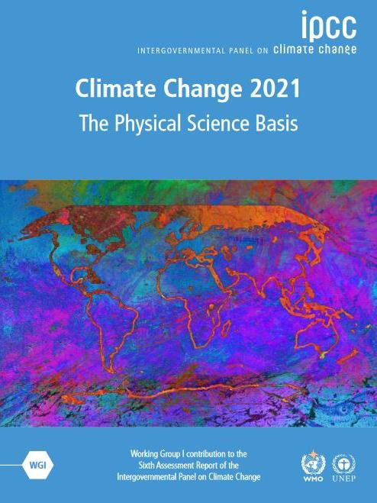
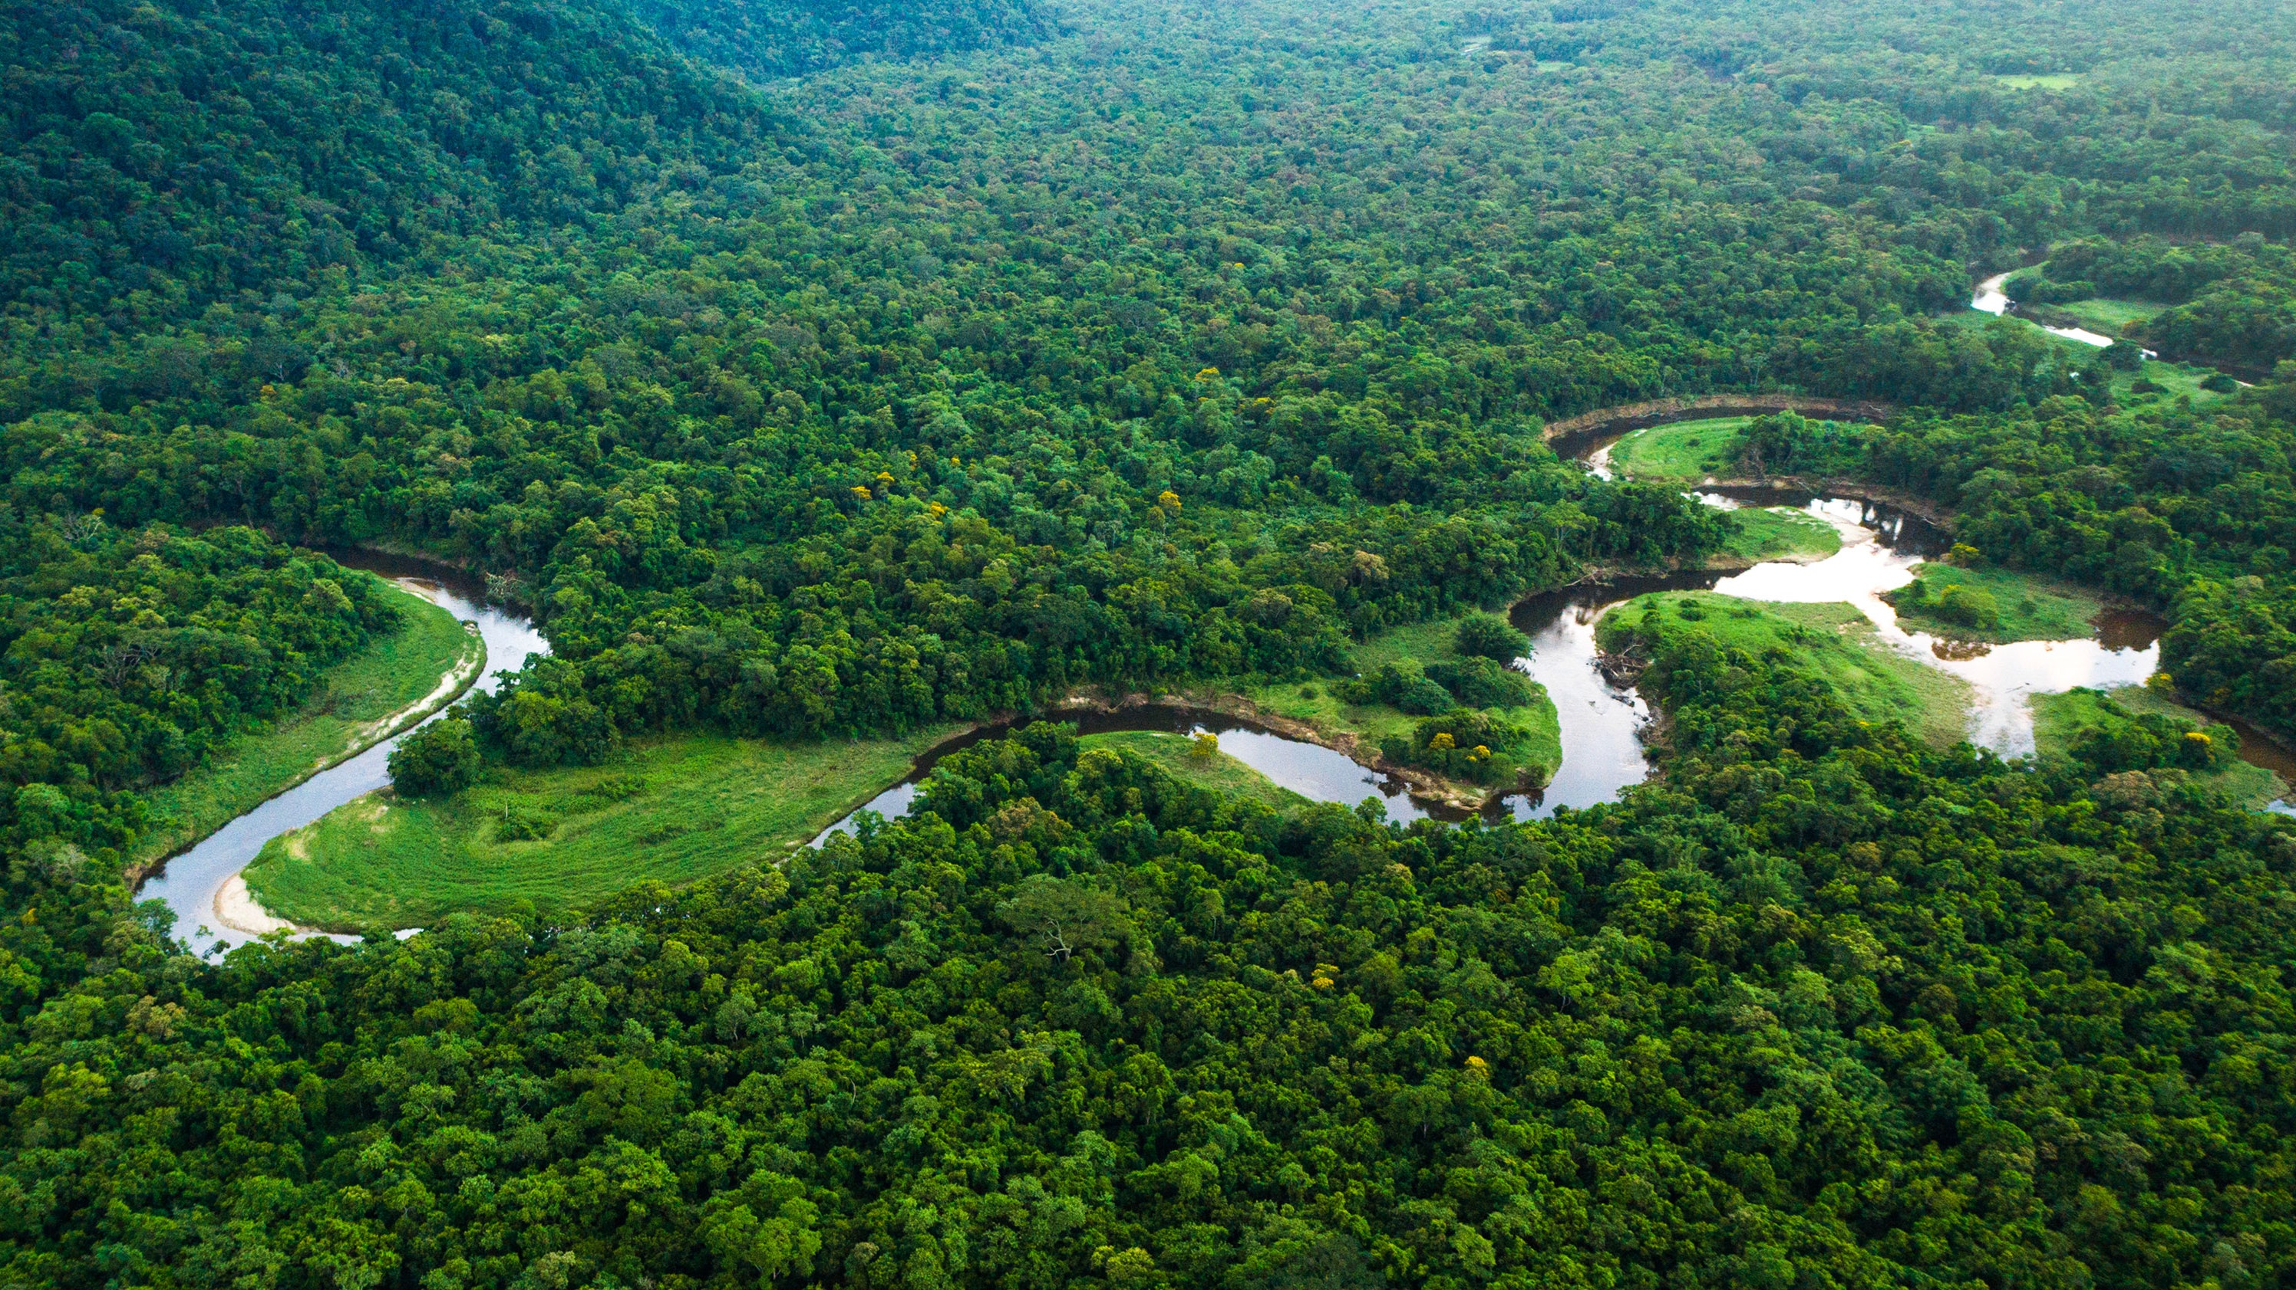

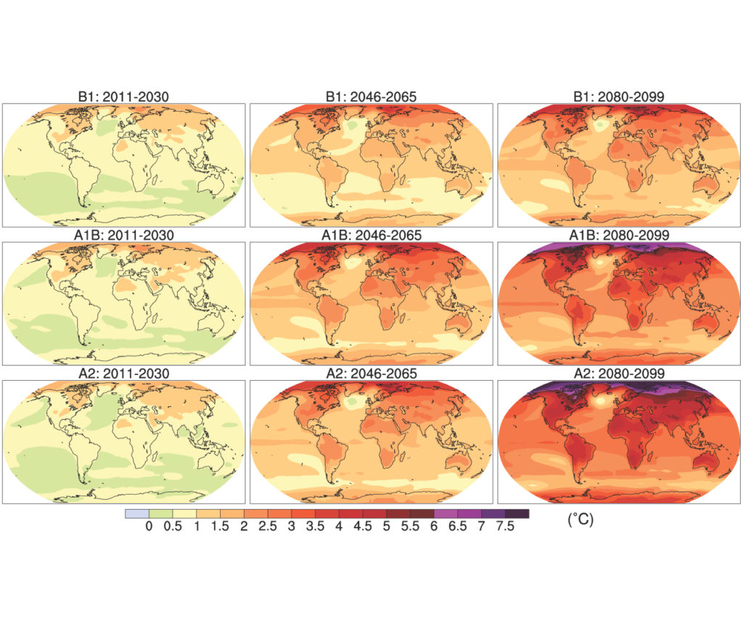
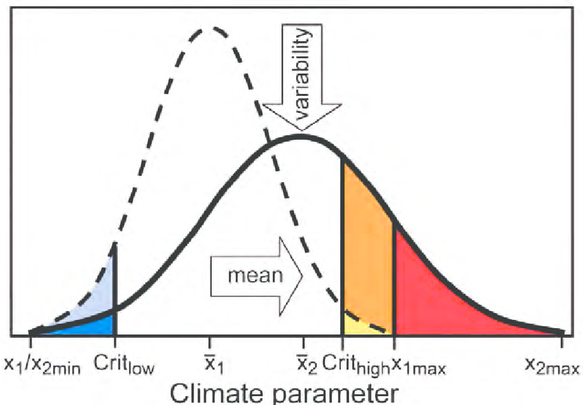
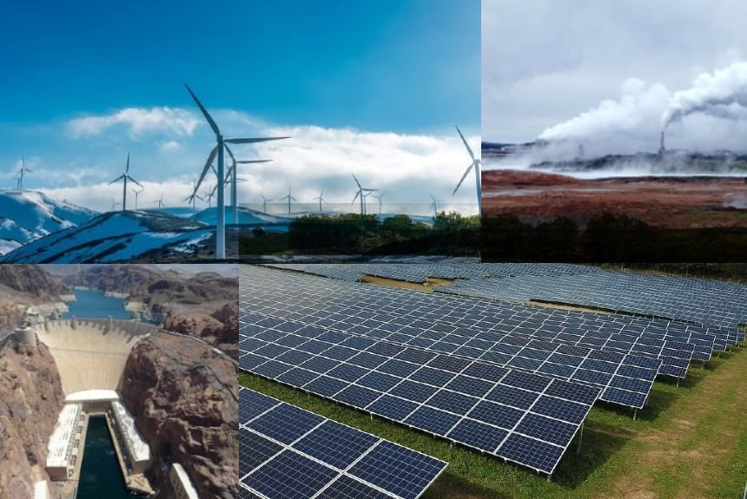
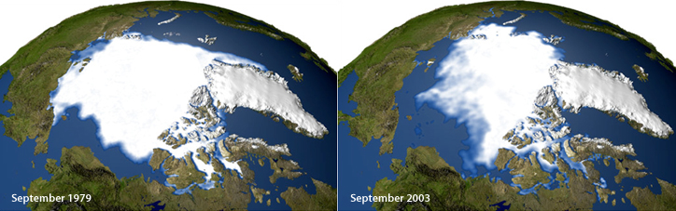
Atmosphere
Climate fundamentals
Predicting climate
Atmosphere
Global C cycle
IPCC report
Earth system models
Climate impacts
Climate solutions
Extreme events
Tipping points
Sea ice, ice caps,
Energy
Mitigation
Nature-based solutions

Slide 3
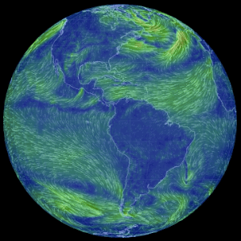
Why is the movement of air masses important?

Slide 4
What drives air movement?
Temperature
Pressure

Slide 5
The ideal gas law
Number of moles of gas
pV=nRT
Temperature (K)
Pressure
(kg m⁻² or Pa)
Volume
(m³)
Ideal gas constant
(J K⁻¹mol⁻¹)

Slide 6
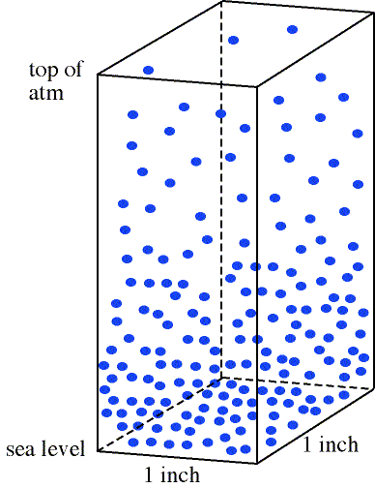
Air pressure
The force exerted by the mass of air over a ground area

Slide 7
Air pressure
Less air molecules at the top of the atmosphere– lower pressure
Sea level pressure as a reference value

Slide 8
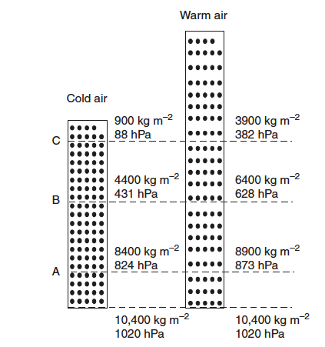
Air pressure and temperature
Following the ideal gas law, warm air is less dense than cold air, leading to lower pressure
Notes:
Ecological Climatology, ch. 5

Slide 9
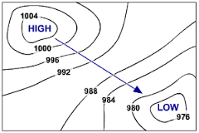
Air moves from high to low pressure
Isobars – Lines of equal pressure

Slide 10
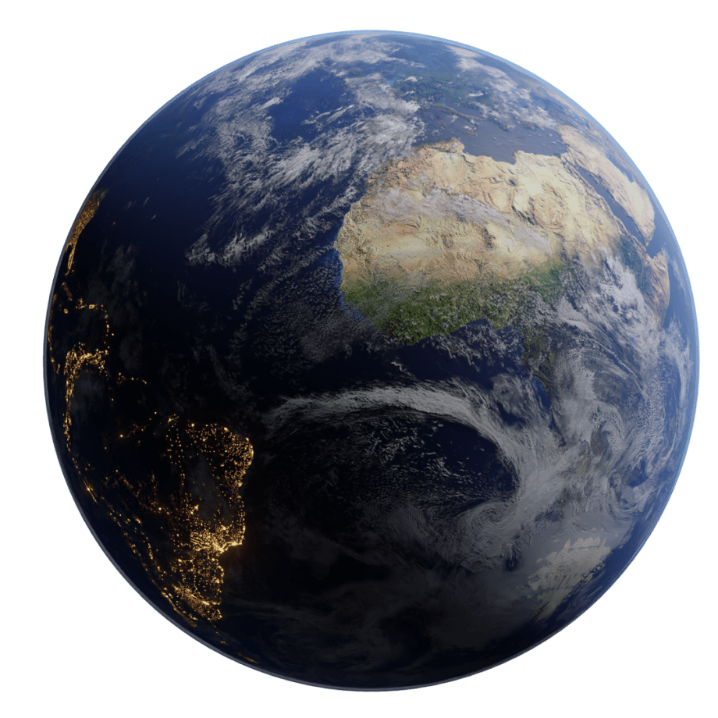
The atmosphere is 3D We always account for both horizontal and vertical air movement

Slide 11
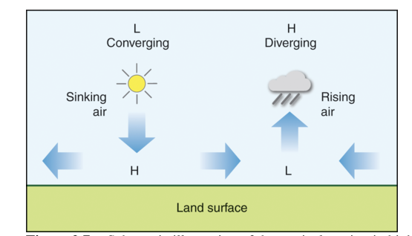
High and low pressure systems

Slide 12
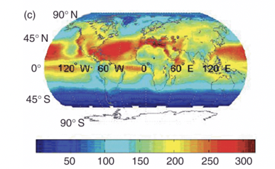
The Earth’s surface is heated unevenly

Slide 13
Global scale
Synoptic or regional scale
Mesoscale
Local scale

Slide 14
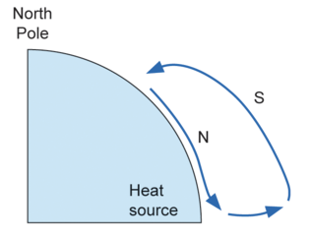
The single cell model - Hadley cell
Warm air raises from the equator and moves northwards, then starts descending as it cools down

Slide 15
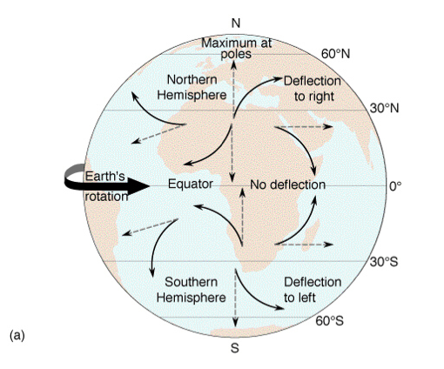
Coriolis effect
Caused by the rotation movement of the Earth
Changes the direction but not speed of the wind
Degree of deflection proportional to the windspeed
Deflection effect increases with latitude, being zero at the equator and highest at the poles

Slide 16
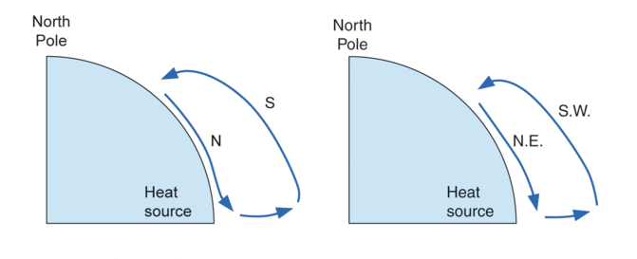
The Hadley cell + Coriolis force
Warm air raises from the equator and moves northwards, then starts descending as it cools down
The Coriolis force deflects the wind to the west aloft and east at the surface in the Northern Hemisphere

Slide 17
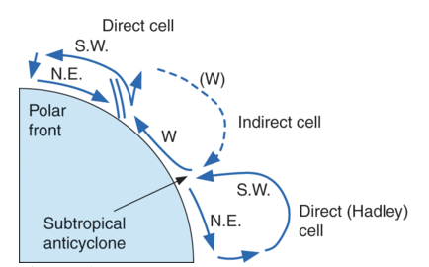
The three cell model
Warm air raises from the equator and moves northwards, then starts descending as it cools down
The Coriolis force deflects the wind to the west aloft and east at the surface in the Northern Hemisphere
Warm air from the mid-latitudes flows polewards and back along the surface

Slide 18
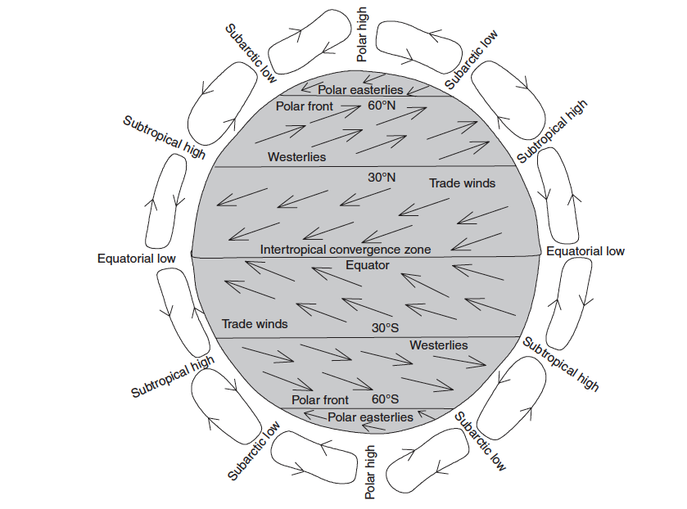
The global circulation

Slide 19
Based on the global circulation patterns, where would you expect to find very dry or arid areas and why?

Slide 20
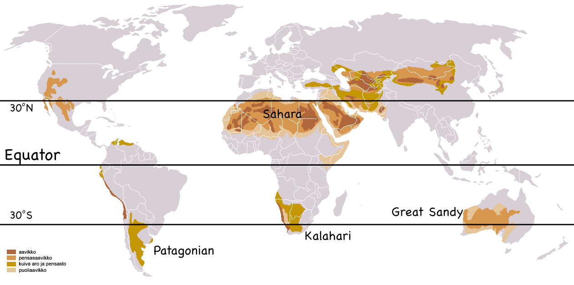
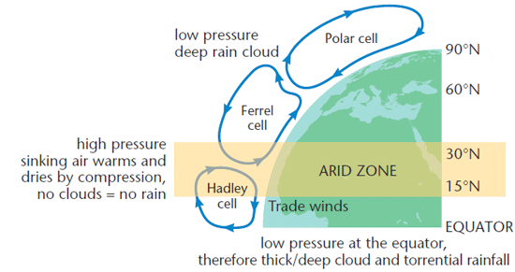

Slide 21
High and low pressure zones give rise to broad climatic zones

Slide 22
Weather definitions: wind
Wind is the movement of an air mass perpendicular to isobars from high to low pressure
Wind speed increases the closer the isobars are

Slide 23
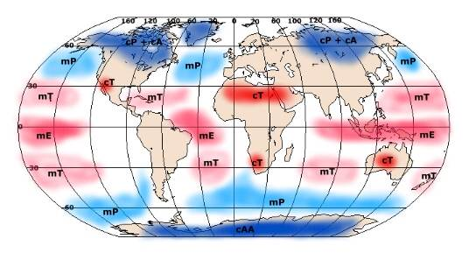
Weather definitions: air mass
A mass of air with consistent temperature and humidity

Slide 24
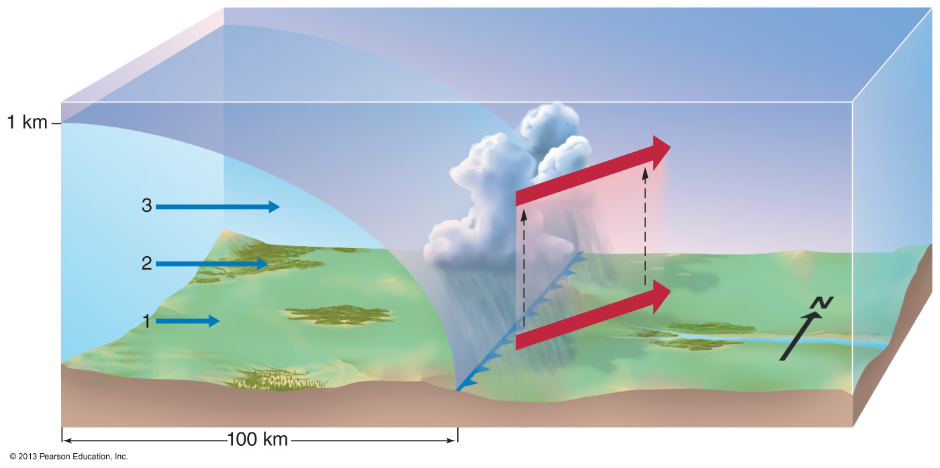
Weather definitions: cold fronts

Slide 25
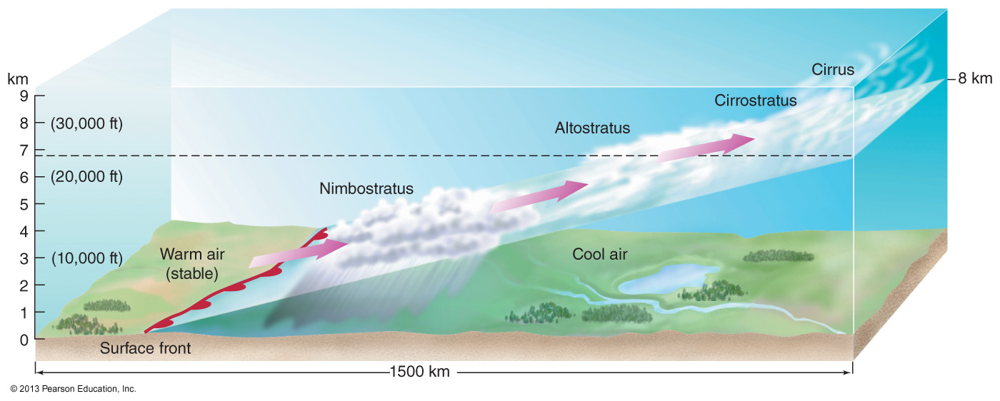
Weather definitions: warm fronts

Slide 26
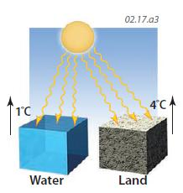
Continents affect atmospheric circulation
Land has a lower heat capacity than water, which means that it both heats up and cools down faster

Slide 27

70% of land surface is in the Northern hemisphere

Slide 28
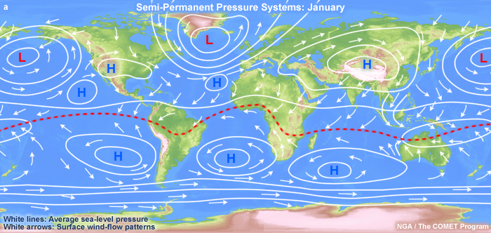
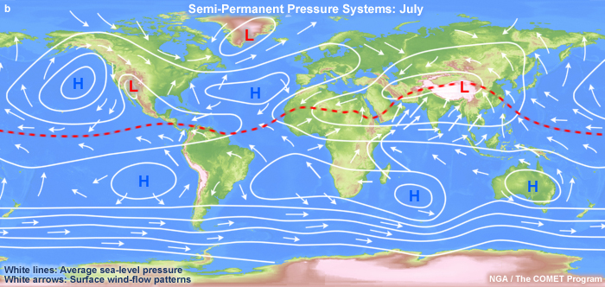
Semi-permanent pressure systems vary temporally and seasonally

Slide 29
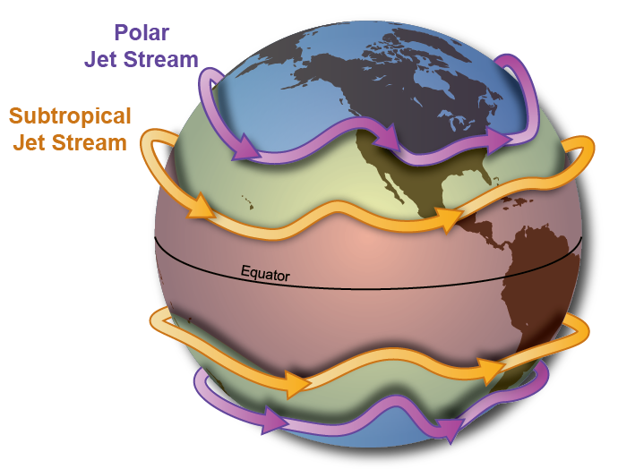
Jet streams
High altitude (upper troposphere), westerly high speed winds

Slide 30
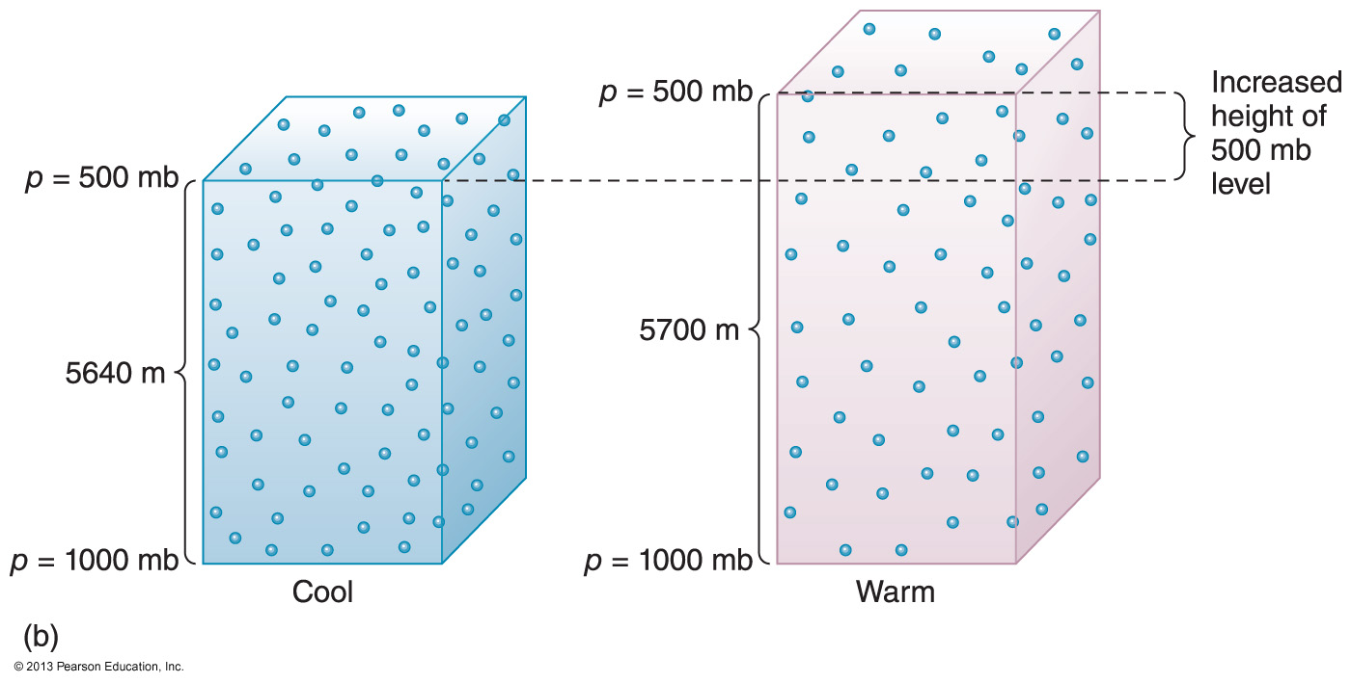
Why do jet streams form in the upper troposphere?
Vertical pressure gradient is smaller for warm air than for cold air

Slide 31
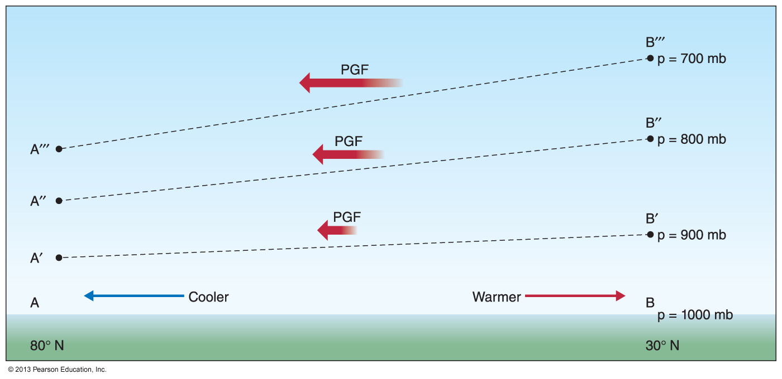
Why do jet streams form in the upper troposphere?
Pressure gradients increase with altitude

Slide 32


Air masses are moved along the jet stream, leading to relatively rapid changes in weather
Areas far away from a jet stream are stable, leading to heatwaves or droughts

Slide 33
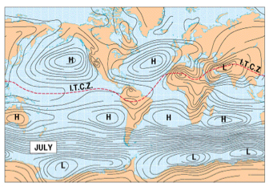
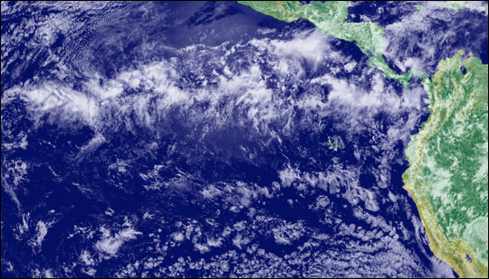
Intertropical convergence zone (ITCZ)
Convergence of northeast and southeast trade winds in equatorial regions creates the intertropical convergence zone

Slide 34
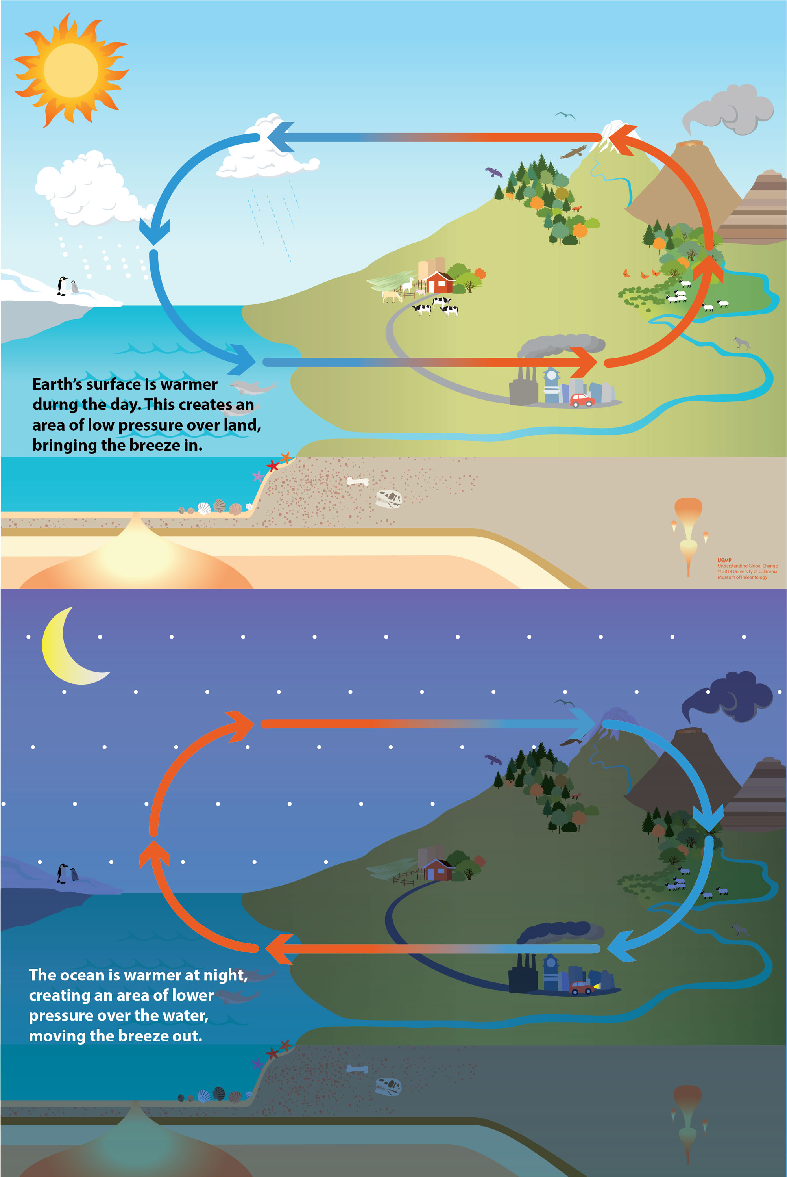
Local winds: sea breezes

Slide 35
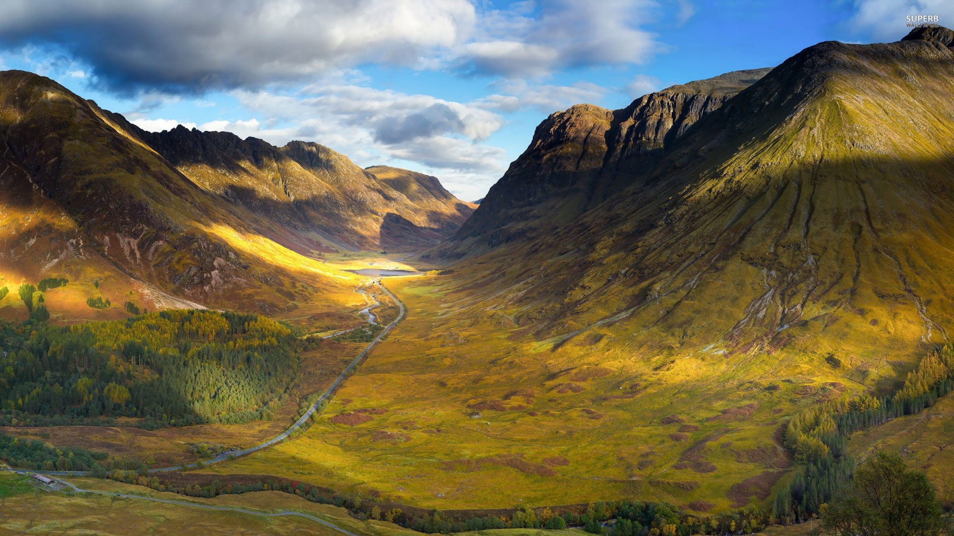
Local winds: mountain and valley breezes

Slide 36
Local winds: mountain and valley breezes

Slide 37
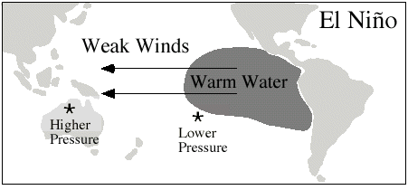
ENSO – El Nino Southern Oscillation
3-7 year cycle associated with a change in sea surface temperature in the Pacific and a weakening of trade winds

Slide 38
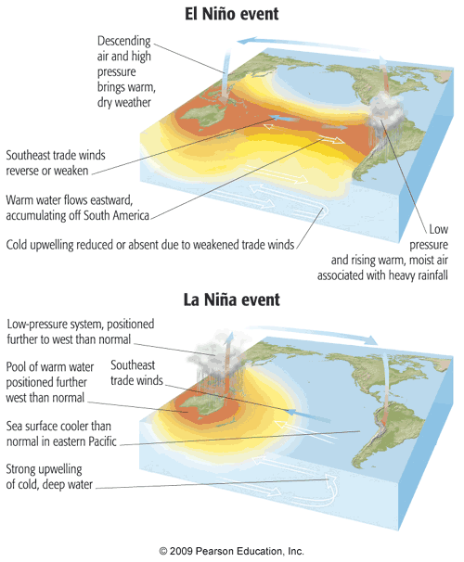

Slide 39
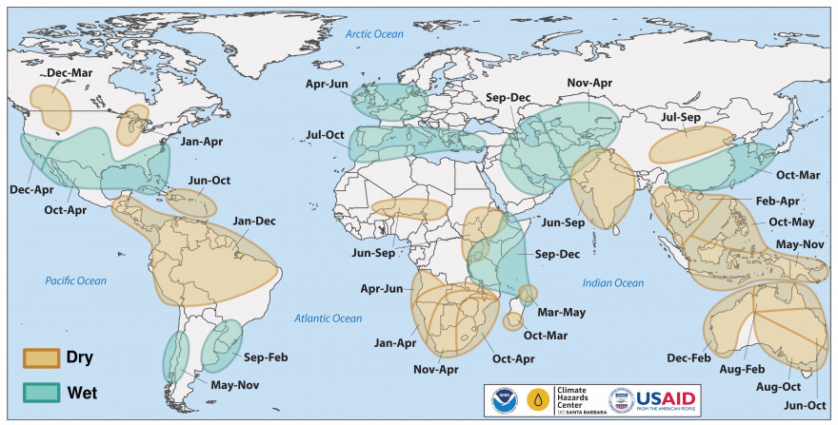
Rainfall during El Nino

Slide 41
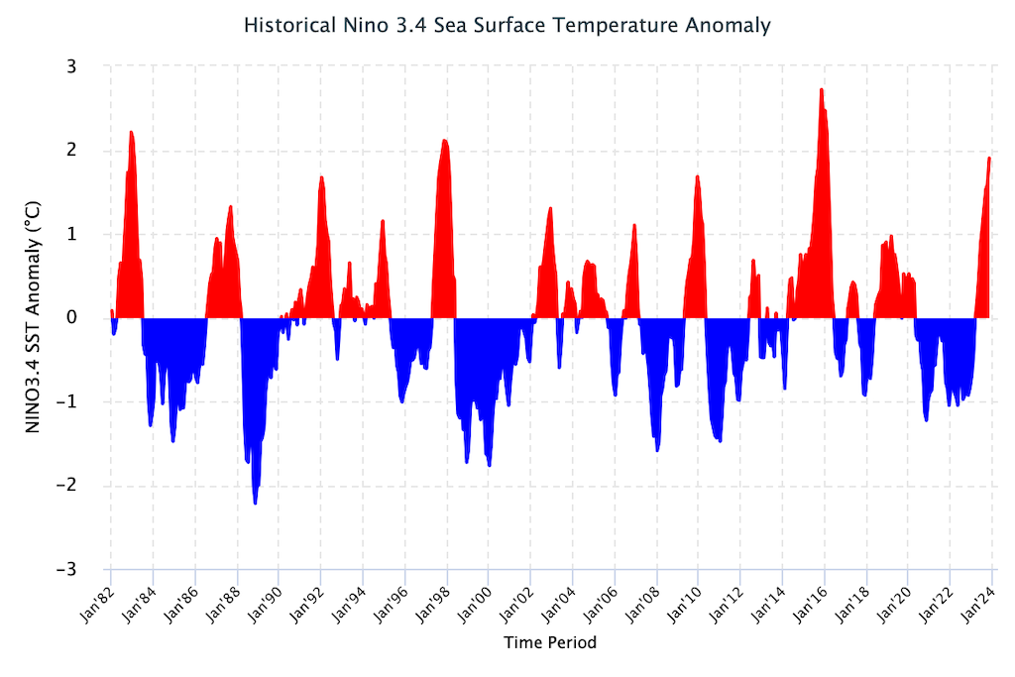
ENSO timeseries

Slide 42
Atmosphere
Climate fundamentals
Predicting climate
Atmosphere
Global C cycle
IPCC report
Earth system models
Climate impacts
Climate solutions
Extreme events
Tipping points
Sea ice, ice caps,
Energy
Mitigation
Nature-based solutions

